Slide 1

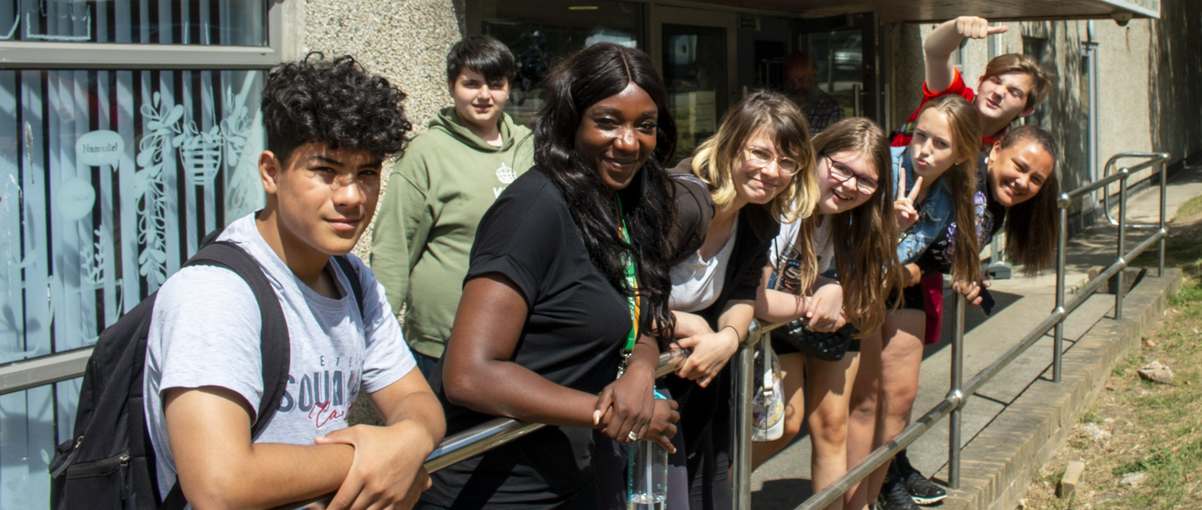
ThinkForward
Progression Coach – Nottingham, Maternity Leave Cover
Job information pack

Slide 2

About ThinkForward
ThinkForward exists to support young people to create better and brighter futures. We want them to be able to identify, realise and shape their aspirations and be ready to make a successful transition into work.
Young people experiencing barriers such as challenging relationships, living in low-income households, or growing up in areas with a lack of access to opportunities can be confronted with hurdles. Without the right support, these barriers can lead to a high risk of unemployment and long-term effects on career and life chances.
There are more than 900,000 16-24-year-olds in the UK who are not at school or college, or don’t have a job or training place. Our ambition is to prevent young people becoming one of these statistics.
In 2026, we will be supporting more than 1,500 young people.
For more information on ThinkForward, our vision and mission, our programmes and equalities manifesto, please visit our website.

Slide 3
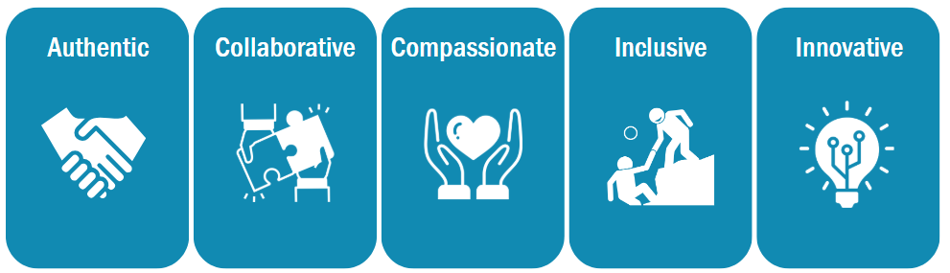
Our values
Our values are more than words; they are the principles that guide our actions and decisions every day. By embodying these values, we create a positive and empowering environment for ourselves, our colleagues, and the young people we serve.
Read more about how our values are embedded in our work here.

Slide 4
EDI Manifesto
ThinkForward is committed to being a place where all can thrive. We place equity, diversity and inclusion at the heart of all we do as an employer, in our work with young people and within our sphere of influence. We value authenticity, compassion, collaboration, inclusion and innovation, and are intentional about underpinning these values with equity, diversity and inclusion practices.
We are working to create a world where our young people are more likely to thrive, and the absence of uniformity is considered a strength. We are wholeheartedly committed to continuously learning, challenging the status quo and creating a space where people’s ethnicity, gender, age, sexual orientation, religious beliefs, disabilities, learning abilities or socio-economic origins are not the defining characteristics of their potential for success. We ensure that all voices are heard and that each person’s strengths are valued and utilised.
To embed our manifesto into ThinkForward practices, our EDI group is committed to continuous implementation and monitoring of key areas including representation, learning and education, policies and procedures, and accountability.

Slide 5


Our principles
ThinkForward is committed to safeguarding and promoting the welfare of children, young people, and vulnerable adults and expects all staff and post holders to share this commitment. ​
​
ThinkForward is committed to equality of opportunity for all staff and applications from individuals are encouraged regardless of age, disability, sex, gender identity, sexual orientation, pregnancy and maternity, race, religion or belief and marriage and civil partnerships. ​
​
As a registered Disability Confident employer, ThinkForward has an accessible recruitment process. We offer interviews to all applicants who meet the job requirements and who declare themselves as having a disability. If you need support, such as materials in larger print, dyslexic-friendly fonts or adjustments for the interview, please contact jobs@thinkforward.org.uk and we will ensure you have what you require to successfully complete this process.

Slide 6
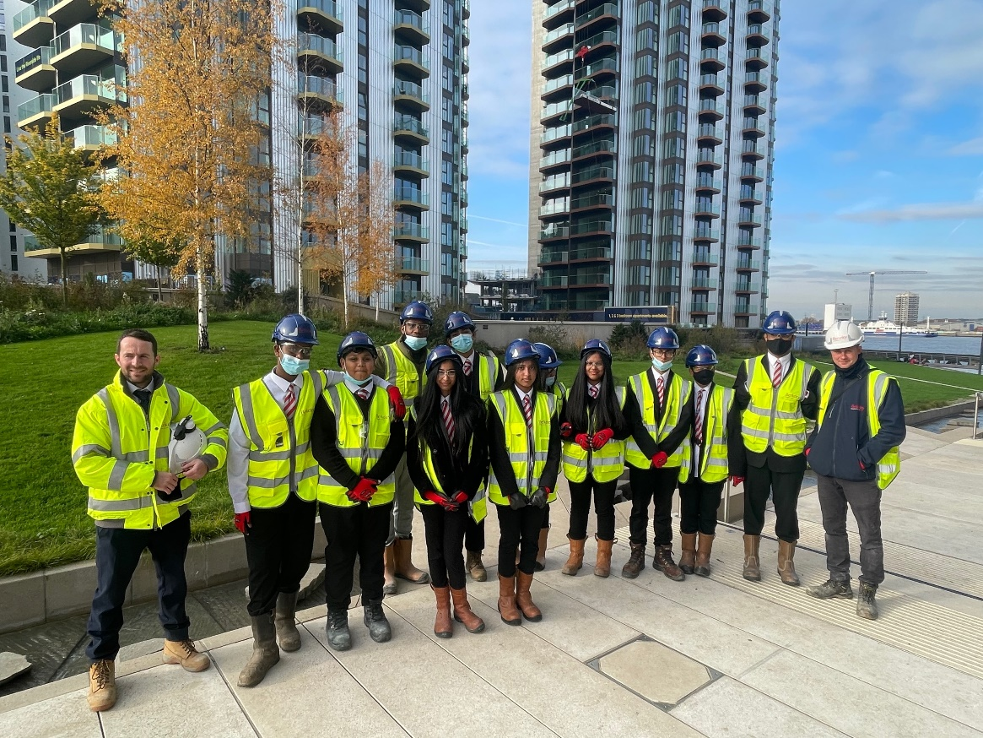
About our programmes
The FutureMe programme provides five years of personalised coaching and employability activities to get young people ready for the world of work. Coaches build trusted relationships, supporting young people to take control, find solutions to challenges, develop skills and create a positive vision for their future.
Specialised ready for work activities support young people to get familiar with the workplace, become inspired and identify a pathway to their chosen career. We run this programme in 15 schools in North and East London, Nottingham and Kent.

Slide 7
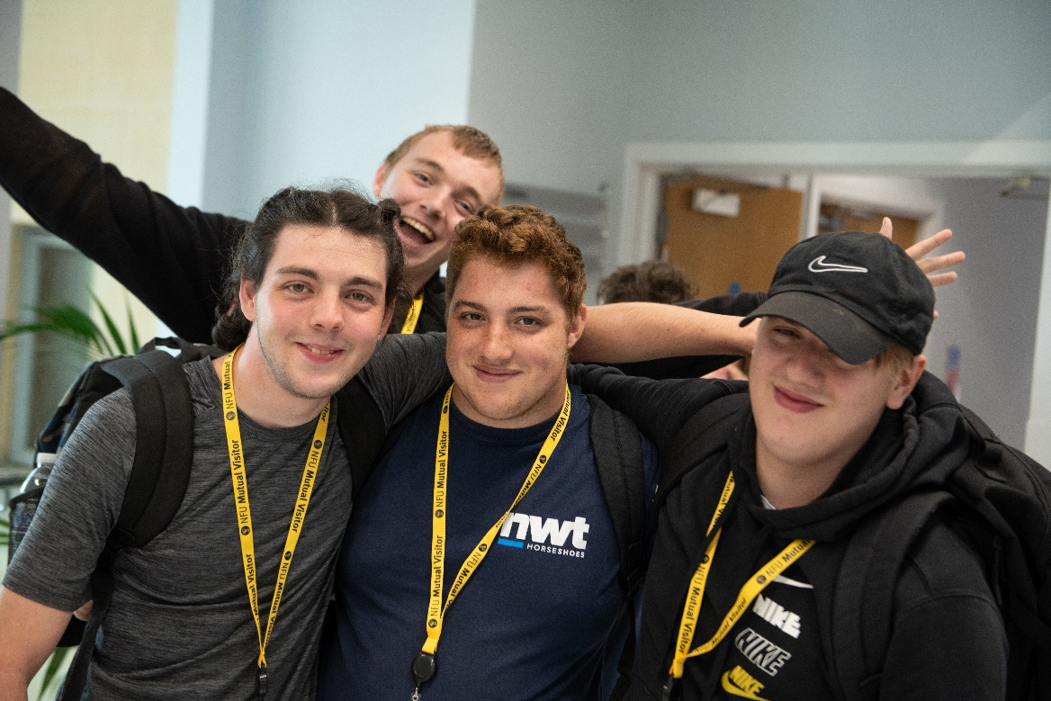
About our programmes
The Work Forward programme operates in London, Kent, and Nottingham, working with young adults aged 16 – 24 who reside in low-income households to support them into sustainable paid employment.
The programme provides young people with a specialist Progression Coach for up to one year.
Coaches offer support through one-to-one
coaching sessions, group workshops and facilitating employer connections.
Young people on the programme have access to a range of support to help them identify their future aspirations, develop their skills, access peer support, and ultimately secure paid employment.

Slide 8
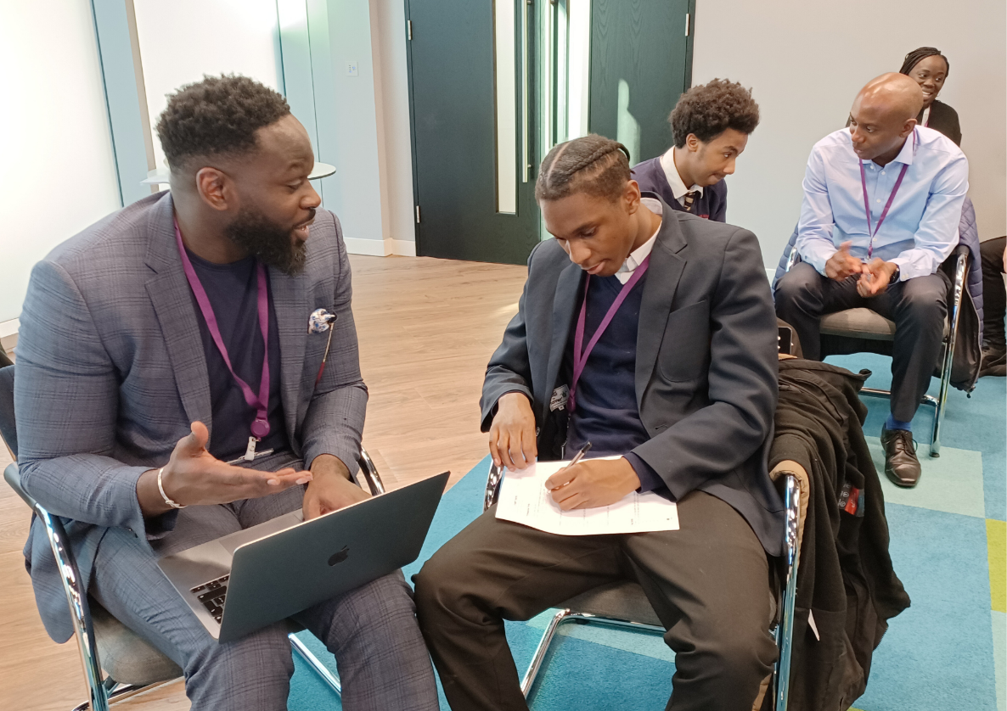
About our programmes
The Future Leaders programme works with young Black men and young Black and Asian women that are at risk of exclusion or have been excluded from mainstream school.
In London, young Black students are more likely to be excluded from school than white British students and young Black men experience disproportionately high unemployment rates.
To tackle these issues, Future Leaders supports Black students in alternative provisions and schools to make a successful transition into a post-16 destination, overcome the barriers they may face such as a lack of networks, social capital and soft skills, and prepare them to be ready to find a fulfilling career.

Slide 9
About the role
This position is a 12 month, fixed term role in central Nottingham, covering for one of our Progression Coaches who will shortly be taking maternity leave.
Our Progression Coaches are at the heart of the ThinkForward initiative. Coaches provide young people with personalised one-to-one coaching and group activities, as well as exposure to the world of work and cultural enrichment activities. Coaching enables young people to overcome challenges holding them back from achieving their potential and ultimately a safer and more successful pathway into employment and adulthood. Our young people are supported by ThinkForward for five years, from 13-18 years old.
Our Progression Coaches project manage the ThinkForward programme within one of our schools and its local community, ensuring that quality and impact is achieved, while also managing successful relationships with our partner schools and businesses.

Slide 10

If this sounds like your kind of role, we want to hear from you!
For job description and person specification details please click here.
Please send your CV and cover letter to jobs@thinkforward.org.uk
Your cover letter should be no more than 2 pages and should outline your suitability for the role as described in the person specification. If you require any reasonable adjustments during the application period, including submitting your application via a telephone call, please email jobs@thinkforward.org.uk so we can make arrangements for you.

Slide 11
The details
Contract: Full-time, 12-month fixed term contract
Salary: From £31,000 per annum
Start Date: September 2026
Location: Central Nottingham
Closing Date: 31/07/2026
Interviews: 1st stage week commencing 03/08/2026, 2nd stage TBD
ThinkForward offer a range of employee benefits including:
Pro rata 25 days annual leave
3 additional days’ leave for office closure days between Christmas and new year
Up to 2 days’ leave for volunteering or 4 half days to support wellbeing
A commitment to personal development
4.5% employer pension contributions - 1.5% more than the statutory minimum of 3%
Interest free employee loans
Cycle to work scheme
Employee discounts and rewards scheme
Employee Assistance Programme
Flexible bank holidays

Slide 12

ThinkForward
0300 102 4475
info@thinkforward.org.uk www.thinkforward.org.uk
Bluesky: @thinkforwarduk.bsky.social
Instagram: @thinkforwarduk
LinkedIn: thinkforward-uk
ThinkForward is a charity registered with the Charity Commission.
Registration number 1152862.

